Slide 1
Longest Common Subsequence
lcs :: [char] -> [char] -> int
int lcs (String,String);

Slide 2
Sample cases
test testtest -> 4
testtest testatest -> 8
testof taesaaaaaaaat -> 4
testof taesaaaaaaaatof -> 6
testoftest taesaaaaaaaatasdptest -> 8

Slide 3
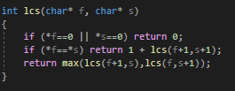

Naive code
best case: two inputs are same, example: “test” “test”
Ω (N) worst case: two inputs have lcs of 0, example: “test” “foobar”
O (2^N)

Slide 4
Calculation table
 | t | e | s | t | c | c | c
t | +1
e |  | +1
s |  |  | +1
a
t |  |  |  | +1
./sunum1cpp testccc tesat recursive native

Slide 5
Dynamic programming
Dynamic programming is the method used for dividing problems into multiple pieces and solve each piece only once to reach the answer.

Slide 6
Fields where dynamic programming is heavily used
Graph partitioning: Used to compliment Fiduccia-Mattheyses heuristic for graph partitioning problem to optimize amount of wire required for a VLSI design.
Matrix chain multiplication.
Dijkstra alghoritm.
multidimensional Pareto front.

Slide 7
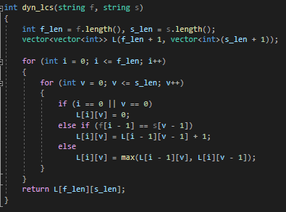
Dynamic programming solution
All cases take M*N time
Beats naive code at Worst case but is worse at best case of naive code.

Slide 8
Calculation table
 |  | t | e | s | t | c | c | c
 | 0 | 0 | 0 | 0 | 0 | 0 | 0 | 0
t | 0 | 1 | 1 | 1 | 1 | 1 | 1 | 1
e | 0 | 1 | 2 | 2 | 2 | 2 | 2 | 2
s | 0 | 1 | 2 | 3 | 3 | 3 | 3 | 3
a | 0 | 1 | 2 | 3 | 3 | 3 | 3 | 3
t | 0 | 1 | 2 | 3 | 4 | 4 | 4 | 4
./sunum1cpp testccc tesat

Slide 9
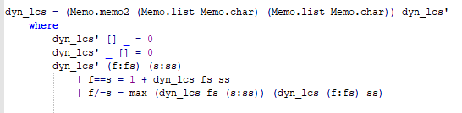
Dynamic programming with memoization
Uses lazy evaluation to calculate values only when required
Complexity depends on data structure used (binary tree in this case)
Same as the recursive code but caches calculated values
best case: two inputs are same, example: “test” “test”
Ω (N*M*log(N) worst case: two inputs have lcs of 0, example: “test” “foobar”
O (N*M*log(N))

Slide 10
Test cases
./sunum1hs testoftesthsjdjkhasnhjd taesaaaaaaaatasdptestaaaaaaaaa recursive
./sunum1hs testoftesthsjdjkhasnhjd taesaaaaaaaatasdptestaaaaaaaaa

Slide 11
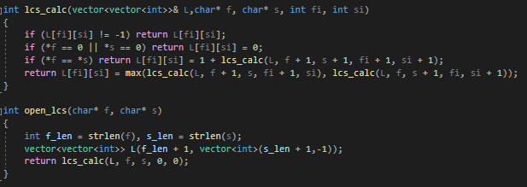
Memoization with arrays
best case: two inputs are same, example: “test” “test”
Ω (N) worst case: two inputs have lcs of 0, example: “test” “foobar”
O (N*M)
Has more overhead compared to other solutions

Slide 12
Calculation table
 |  | t | e | s | t | c | c | c
 | 0
t |  | +1
e |  |  | +1
s |  |  |  | +1 | +0
a |  |  |  | +0 | +0 | +0
t |  |  |  | +0 | +1 | +0
./sunum1cpp testccc tesat a

